Slide 1
Study Trip Brief
CYBER SECURITY
20TH MAY, 2019.

Slide 2
PRESENTATION OUTLINE
CYBER SECURITY (focus of the Course)
ARTIFICIAL INTELLIGENCE
VIRTUAL/AUGMENTED REALITY

Slide 3
CYBER SECURITY
Cybersecurity
Information security vs Cybersecurity
Cybersecurity Objectives
Cybersecurity Governance
Cybersecurity Domains

Slide 4
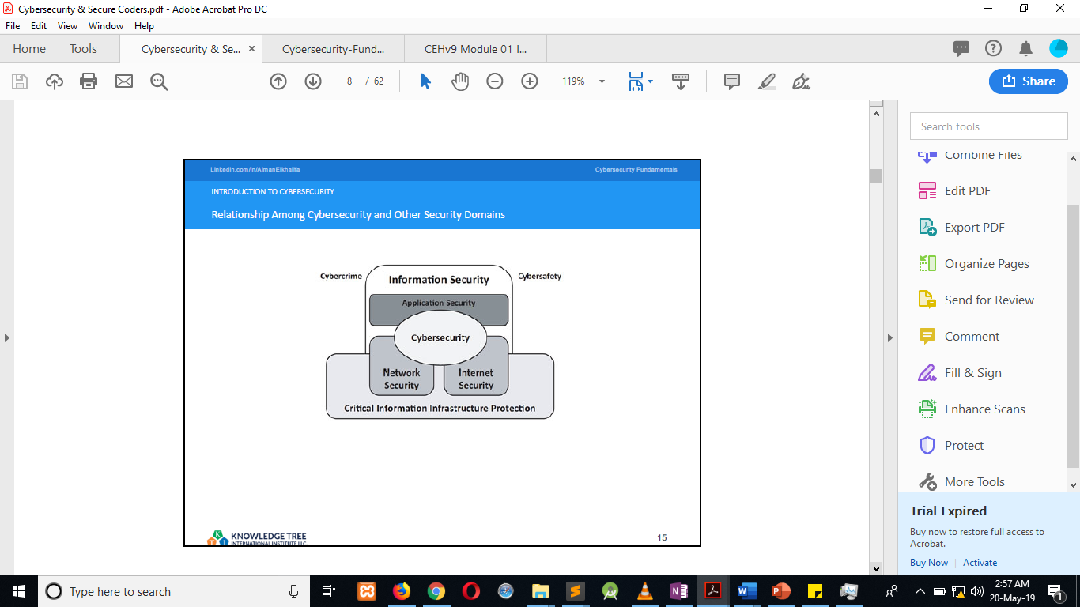
CYBER SECURITY

Slide 5
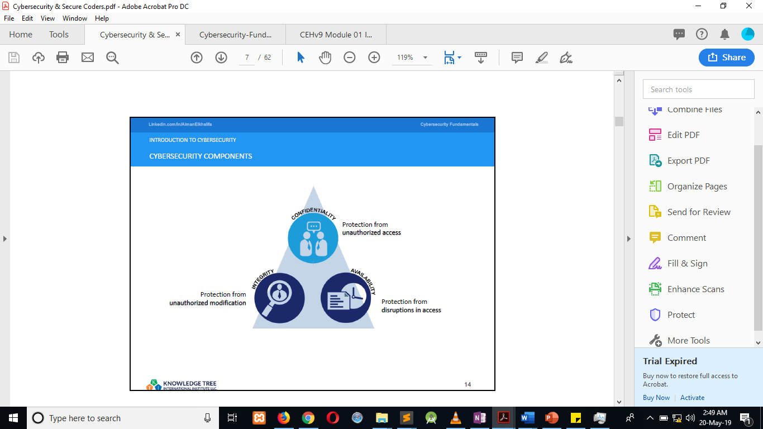
CYBER SECURITY

Slide 6
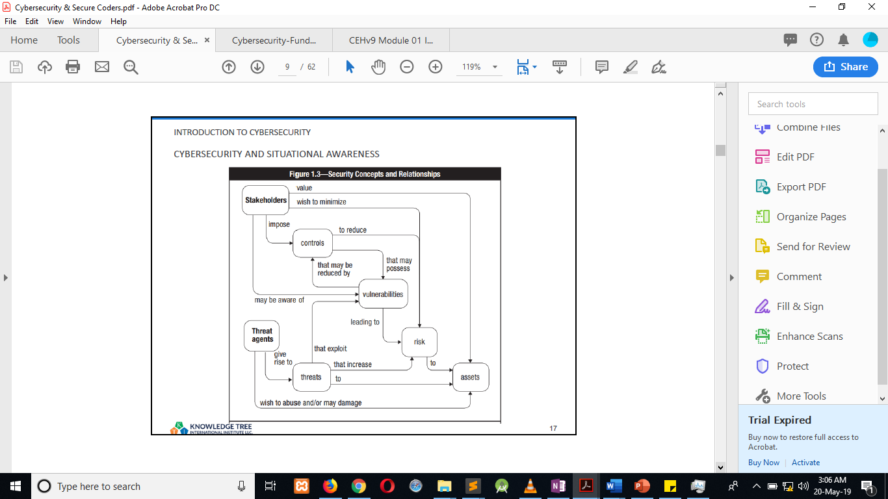
CYBER SECURITY

Slide 7
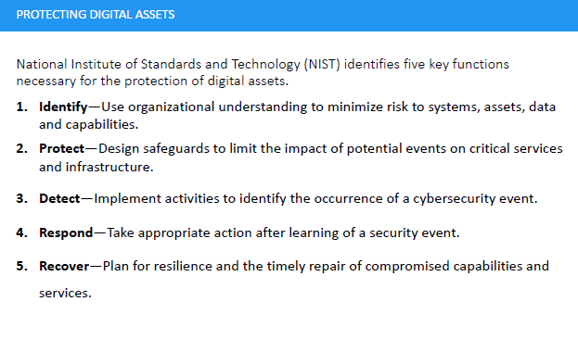
CYBER SECURITY

Slide 8
ARTIFICIAL INTELLIGENCE
DARKTRACE CYBER DEFENSE AI SOLUTION
An Enterprise immune system that applies AI to the cyber defense challenge to detect cyber threats that legacy systems cannot.
ENTERPRISE SECURITY SOLUTION
Innovation in artificial intelligence, machine learning, and deep learning will enable businesses to secure their commercial and digital assets in a cost-effective manner.
SMART CITY VISION
Our cities and regions hum with the possibilities unleashed by constant connectivity, easy access to massive computational power, exponential increases in data and even human-machine interaction.

Slide 9
ARTIFICIAL INTELLIGENCE
HUAWEI WI-FI 6 (AI WI-FI)
The future-speed WI-FI providing intelligent assurance powered by AI.
IYANTRAS EMOTION INTELLIGENCE SYSTEM
Cognitive digital agent, cognitive process automation, cognitive surveillance, facial recognition, media intelligence, natural language processing, predictive intelligence, smart cities, smart retail experience.
INSIGHT AI
Insight API helps to scale your media processing through the power of AI. Improve efficiency and optimize processes and achieve results you thought impossible.

Slide 10
VIRTUAL/AUGMENTED REALITY
MAGICPLAN APPLICATION
The application is use for the creating of blueprint of any kind of building.
VIRTUAL APARTMENT

