Slide 1
Cyber Security
Presented By:
Cyber Security Team
3rd July, 2019.

Slide 2
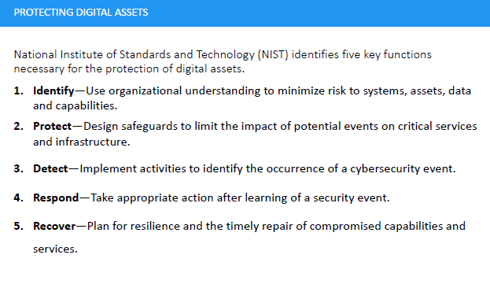

Slide 3
Identification of Systems & Data
Inventory of Systems [ Servers, Clients, Storage devices, network, operating systems, firewalls, etc].
Vulnerability Assessment [ weak point of entry into our network]

Slide 4
FC-Systems: Vulnerability Assessment
Exposure of Sensitive Information in the Public Domain.
Insecure Official Domain [SSL Certificate not implemented]
Poor Client Machine Configurations
Poor Server Computer Configurations

Slide 5
Recommendations
Conduct a Full Vulnerability Assessment on All FC’s Cyber Assets.
Design Cyber Safeguards based on the Assessment.
Re-configuration of Server and Client Computers.
Implement SSL Certificate on the fcghana.org domain.
Limit the type of Information we share on Public domain.

Slide 6
Thank You!!!

